Slide 1
Niagara
College
Canada
Office Administration
General and Executive

Slide 2
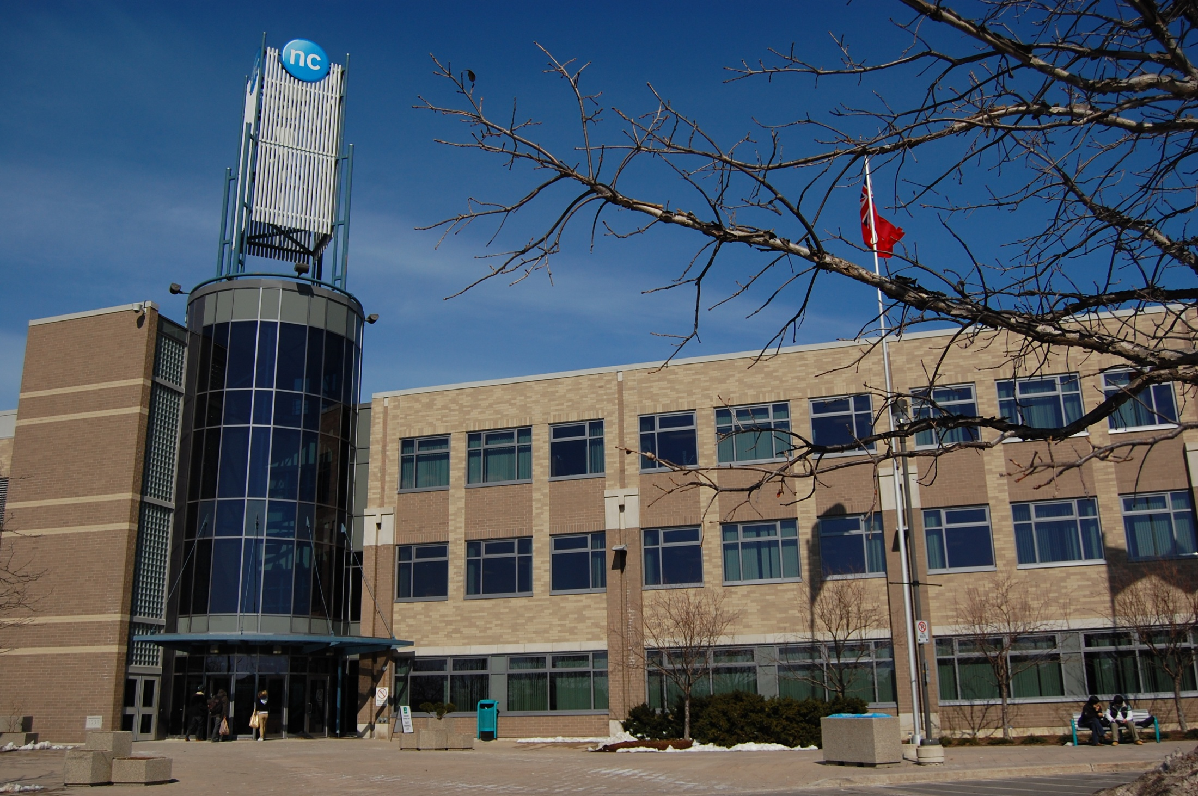
Niagara-on-the-Lake Campus

Slide 3

Why Should I Choose Niagara College?
my

Slide 4
Reasons Niagara College Should be Your 1st Choice
6
Latest office technologies
2
3
4
5
6
1
Connected to the business community
A first-rate co-op placement office
Focus on customer service
Supervisory skills training
Interview training, practice makes perfect!

Slide 5
Executives were asked, “Which of the following areas of special training will be most useful for administrative professionals in the future?”

Slide 6

To prepare for success, administrative professionals should take
ACTION at Niagara College
Analysis
Collaboration
Technical Aptitude
Intuition
Ongoing Education
Negotiation

Slide 7


Slide 8

Benefits of Niagara College
Emphasis on computer technology in order to build and update students skills in the competitive job market.
Program outline is equipped to include sophisticated skill sets that meet industry needs.
Graduates are equipped with the administrative knowledge to pursue the following:
      Certified Professional Secretary (CPS)
      Certified Administrative Professional (CAP)
      Membership in the International Association of Administrative Professionals (IAAP)
Small class sizes even though enrolment is up due to the increase in job demand.

Slide 9
General One-Year Program
TERM ONE
Office Environment I
Customer Relations in Society
Business Document Formatting
Word Processing Fundamentals
Spreadsheets I
Communications for Office Administration
Mathematics
TERM TWO
Office Environment II
Advanced Word Processing
Spreadsheets II
Access I
Presentation Skills
Business Communication

Slide 10
Testimonials and Profiles
"The business of policing includes being supported by dynamic and progressive office personnel. In order to be successful, we must employ individuals who are capable of performing advanced level technological and office administration functions. We are very pleased to have hired a graduate of Niagara College's Office Administration program who has demonstrated excellent abilities and has advanced quickly in our organization."
Inspector Scott McLean, Niagara Regional Police Service
"We always hear how difficult it is for people to find a good job. For an employer, the task in finding the right employee, is equally difficult. Fortunately, in employing graduates of Niagara's Office Administration program, their inherent skills, attitude and enthusiasm have made my job easier and our business much better."
  Reid Hodgson, BA, CFP, Director of the
  Private Client Group, Dundee Wealth
  Management (Welland)

Slide 11
Executive Two-Year Program
Office Environment I
Customer Relations in Society
Business Document Formatting
Word Processing Fundamentals
Spreadsheets I
Communications for Office Administration
Mathematics
TERM ONE
TERM TWO
Office Environment II
Advanced Word Processing
Spreadsheets II
Access I
Presentation Skills
Business Communication
General Education Elective (1 required)
TERM THREE
Paid Co-op Work Placement
TERM FOUR
Office Accounting
Supervisory Skills
Integrated Office Projects
Web Page Design
Desktop Publishing
Access II
General Education Elective (1 required)
TERM FIVE
Paid Co-op Work Placement

Slide 12
Testimonials and Profiles
"This program provided me with a strong computer and customer service background as well as the ability to find the resources I need to be successful in my busy work environment. My co-op placement also led me directly into a full-time position at Niagara College. The instructors in the program really cared about me and my success."
Marsha Fiorino, Office Administration - Executive (Co-op) Graduate
“At TRG Insurance, we have had a terrific experience in hiring a co-op student from the Office Administration - Executive program. Students in this program have outstanding skills and are able to demonstrate them with speed and accuracy in a busy workplace. At TRG, we are happy to be a partner in education and training with Niagara College.”
Joanna Wallace, TRG Insurance, Niagara Falls, Ontario

Slide 13
Office Administration Co-op Statistics

Slide 14

The Star of Excellence Award
Earned by students in the Office Administration programs
The purpose is to recognize students for their achievements in academics and extracurricular activities
Achievement is measured on a points basis

Slide 15

What career options are open to me?

Slide 16

Graduates can be employed as...
One-Year Certificate Program
Two-Year Diploma Program
Administrative Assistants
Customer Service Representatives
Receptionists
Office Assistants
Front Desk Coordinators
Administrative Assistants
Bookkeeping Clerks
Project Coordinators
Office Administrators
Executive Assistants

Slide 17
Employment sectors that are in need of Office Administrators
Education
Tourism
Small Manufacturing
Municipal Government
Insurance

